Slide 1







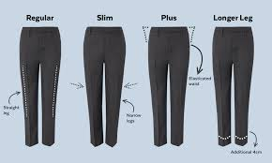
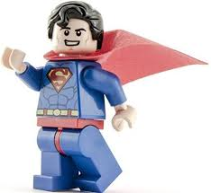
FREDs : Calendar of Events
2019 / 2020
Quiz and Pizza Night: 9th November @ 8pm
Dates for your diary!
NOV 30
DEC 7
MAR 20
JUN 18
Christmas Film Afternoon
2.30-5 p.m.
Pre-Loved Uniform Sale
4-4.45 p.m.
Super Man Sale
9-11 a.m.
MAR 19
MAR 26
JUL 4
Wonder Woman Sale
9-11 a.m.
Easter Surprise
9-11 a.m.
Summer Fete
11-2.00 p.m.
We need your help
Are you able to spare an hour or two every couple of months to help us plan and execute these events?
Are you able to support at the event?
If you can, please don’t hesitate to get in touch with us. We are always looking for willing volunteers, and no contribution is too small!

