Slide 1
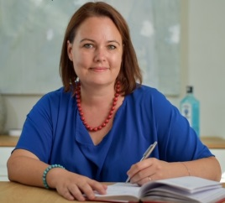
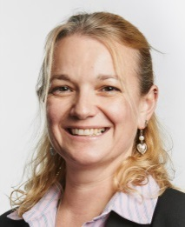
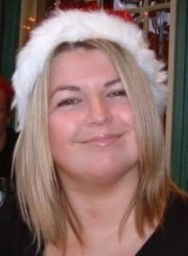
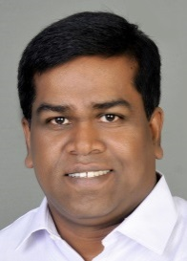
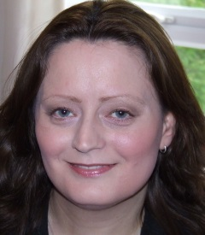
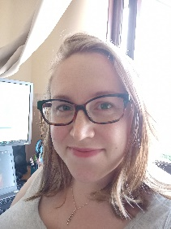
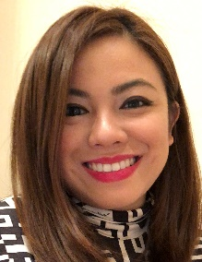
Friends of St Edwards
Meet The Team
Chair
Julie Provino, Year 2
An HR professional and trainer in her spare time. Can work efficiently and under pressure. Used to working with parent’s associations.
Chair
Julie Provino, Year 3
An HR professional, coach and trainer. Can work efficiently and under pressure.
Secretary
Tanya Roberts. Year 2
An experienced Events Organiser who is really enjoying being part of the FREDs team.
Always enjoys a new challenge…
Secretary
Tanya Roberts. Year 3
An experienced Events Organiser who is really enjoying being part of the FREDs team.
Always enjoys a new challenge…
Vice-Chair
Donna Croucher, Year 5
Operations Director for a FTSE 250 search business, leading their Executive HR Practice in the South. Eats far too much at client lunches, and loves a nice glass of wine!
Comms
Senthil Mani, Year 3
Technology professional with a passion to optimize business processes by using latest technologies. He introduced online and card payments for the FREDs' events.
Head of Comms
Senthil Mani, Year 4
Technology professional with a passion to optimize business processes by using latest technologies. He introduced online and card payments for the FREDs' events.
Treasurer
Anna Barefoot, Year 2
A professional accountant who loves playing around with spreadsheets and is looking forward to the challenge of her first FREDs role.
Event Coordinator
Scarlett Murphy, Reception
A university lecturer specialising in teacher training. Organised and looking forward to working with FREDs as a parent.
Online Shop Coordinator
Livia Tan, Reception
A full time mummy who enjoys solving problems and organising everything she gets her hands on, looking forward to her first FREDs role.
FREDs is for everyone at the school. We are very happy for new faces to come to meetings, so please do come along if you can.
If you want to chat, but can’t make the meetings and can’t find us at school, either drop us an email or leave a note in the FREDs suggestion box in the parents’ room at school and we’ll get back to you as soon as possible.
julieprovino@yahoo.com

